Slide 1
Healthcare Billing Prediction Application
Name: Joseph Choi
Class: DSC410-T301

Slide 2
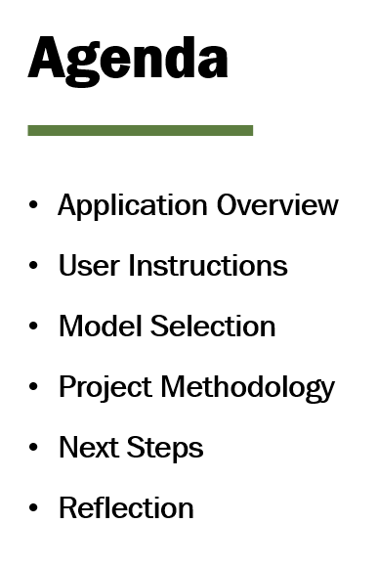
Agenda
Application Overview
User Instructions
Model Selection
Project Methodology
Next Steps
Reflection

Slide 3
Application Overview
Built a predictive healthcare billing app for DSC410-T301
Designed to forecast medical bills for better financial planning
Intended to support healthcare providers and patients in managing finances more effectively
Used the Random Forest Regressor model to predict output
Allows users to input patient data including: Age, Gender, Blood Type, Insurance Provider, Admission Type, Medication, Test Results, and Medical Condition

Slide 4
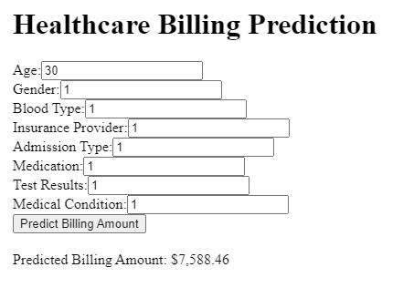
User Instructions Pt. 1
Instructions on application use:
Enter the patient information in the input boxes
When all details are updated, click the button to see the forecasted billing amount
Use the cheat sheet provided in the next slide for features that require encoded value
1
2

Slide 5
User Instructions Pt. 2
3
Gender | Blood Type | Insurance Provider | Admission Type | Medication | Test Results | Medical Condition
Male: 1 | “A+”: 1 | UnitedHealthcare: 1 | Emergency: 1 | Aspirin: 1 | Abnormal: 1 | Pneumonia: 1
Female: 2 | “O+”: 2 | BlueCross: 2 | Elective: 2 | Lipitor: 2 | Inconclusive: 2 | Cancer: 2
 | “A-”: 3 | Cigna: 3 | Urgent: 3 | Penicillin: 3 | Normal: 3 | Diabetes: 3
 | “B+”: 4 | Aetna: 4 |  | Paracetamol: 4 |  | Hypertension: 4
 | “B-”: 5 | Medicare: 5 |  | Ibuprofen: 5 |  | Bronchitis: 5
 | “AB-”: 6 |  |  |  |  | Asthma: 6
 | “AB+”: 7
 | “O-”: 8

Slide 6
Model Selection
Selected Random Forest Regressor model based on the model’s strengths and dataset characteristics
Dataset Characteristics: Conducted thorough EDA and identified that my dataset included both numerical and categorical features, as well as outliers
Model Benefits: Random Forest Regressor models can effectively manage various data types and are less sensitive to outliers, reducing the risk of overfitting
My RF Regressor model’s evaluation metrics indicate strong performance, demonstrating great accuracy
MSE: 57M MAE: 4K R2: 97%

Slide 7
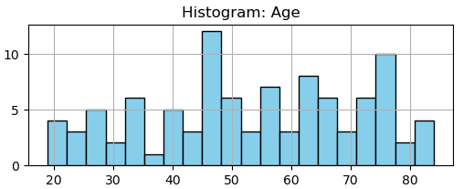
Project Methodology
Project Workflow:
Data Cleaning
EDA
Data Preprocessing
Feature Engineering
Model Training
Hyperparameter Tuning
Additional Steps:
Deployment to Dash app for user interaction
Iterative approach with continuous testing and adjustments

Slide 8
Next Steps…
Future Direction:
Use a larger dataset for improved accuracy and broader learning, as the current model was trained and tested on a small dataset (100 rows)
Explore alternative techniques such as deep learning and ensemble learning to improve predictive capabilities
Continuously iterate on the model development process by using new data, techniques, and feedback for ongoing improvement in predictive performance

Slide 9
Reflection
Great learning experience in model building and deployment
Gained insight into the importance of iterative workflow and trial-and-error process
Learned the significance of staying flexible while uncovering new information through the project
Despite the project’s simplicity compared to real-world data science projects, it offered valuable perspective

Slide 10
Thank you
Name: Joseph Choi
Class: DSC410-T301

